Slide 1


FRAUD DETECTION IN HEALTHCARE INSURANCE
Team Members:
Krithikaa Madhumitha
Lakshmi Sruthi
Monica Chandrasekar
Samyuktha Mahesh
Surya Narayanan
Guided by:
Mr. Animesh Tiwari
Batch Course Group Domain | : : : : | Chennai August 2020 Post Graduate Program in Data Science and Engineering Group 1 Finance & Risk Analytics

Slide 2

INDUSTRY REVIEW
Healthcare industry primarily focuses on the maintenance and progression of health which involves the diagnosis, treatment and prevention of diseases in humans. Every country has its unique healthcare system.
A country's healthcare quality is measured on the following criteria:
Expenditure
Quality
Availability
Population's Health
Upfront Cost

Slide 3

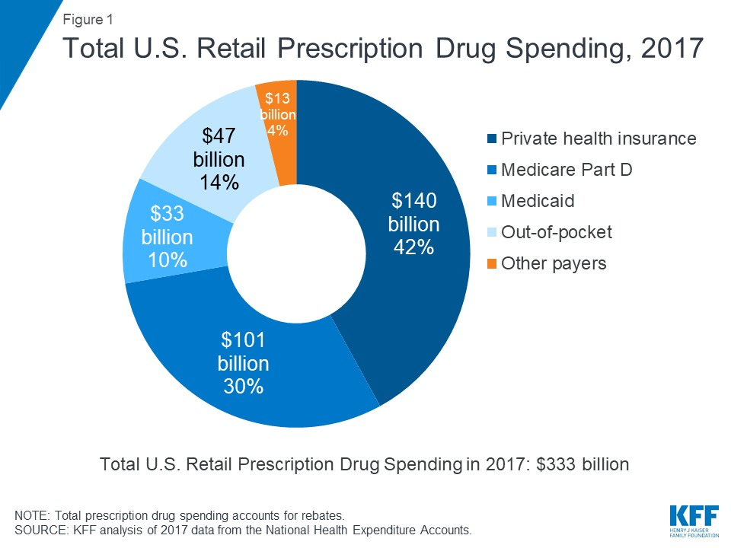
INDUSTRY REVIEW
Being a well developed country, medical expenses are pretty high in US.
People end up getting bankrupt by just paying the bills for the medical expenses.
Around 6,50,000 ppl go bankrupt every year.
Hence the government started looking to find ways where healthcare could be provided for all of its citizens.

Slide 4
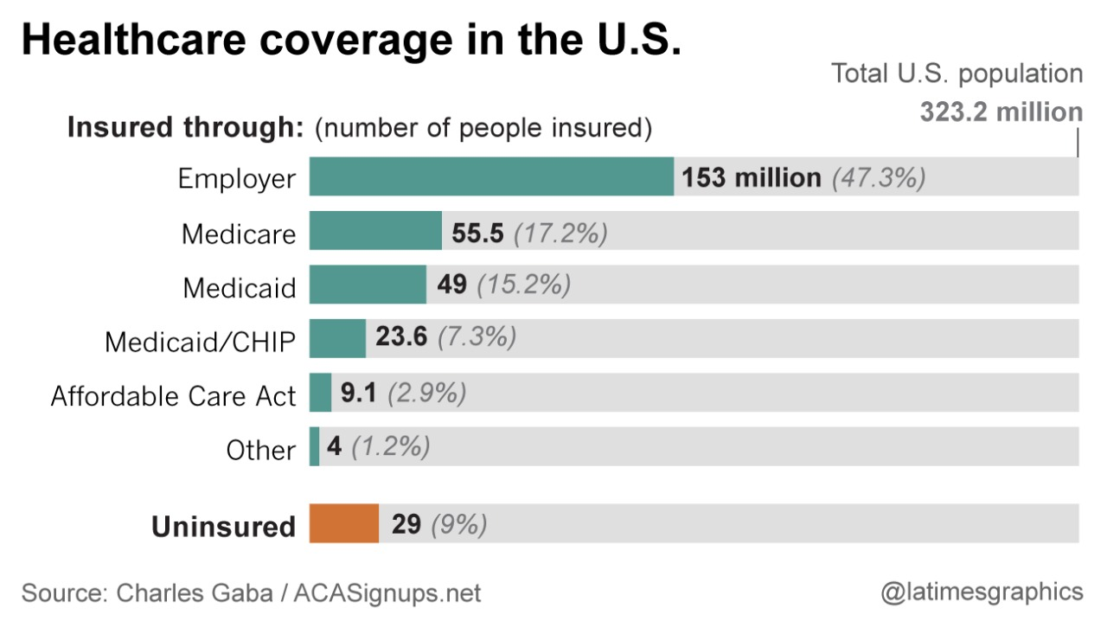

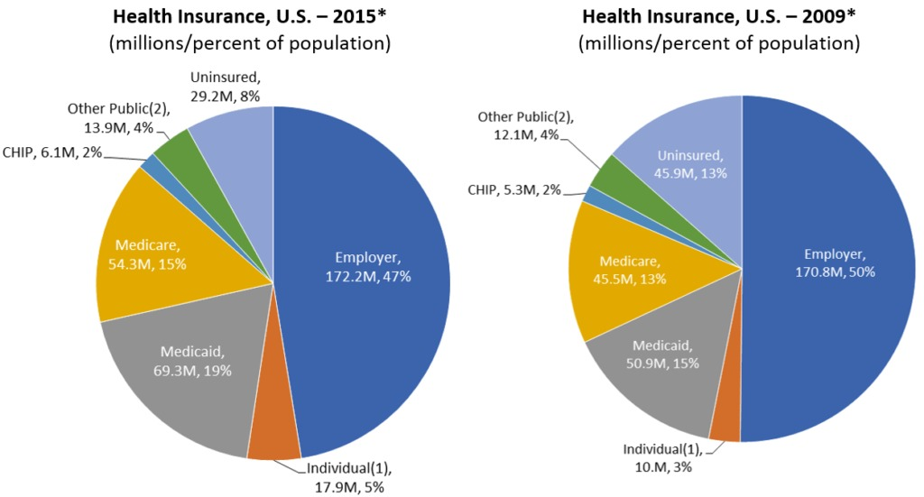
INDUSTRY REVIEW
There are different types of insurance plans that's available in US
Employer-provided
Medicare -for all folks and disabled
Medicaid - mainly for poor

Slide 5
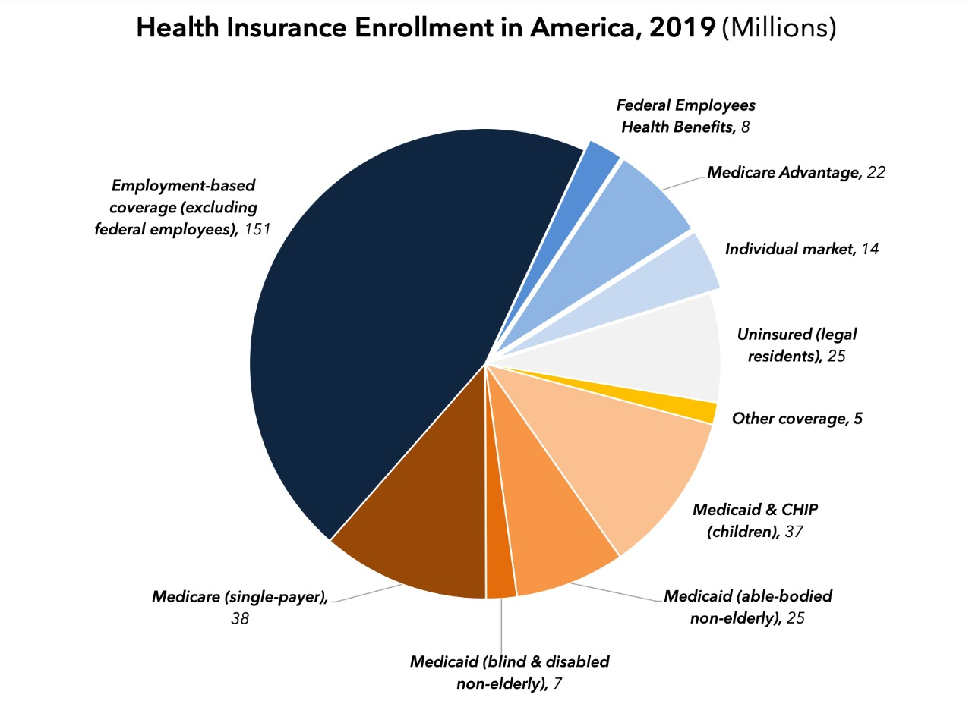
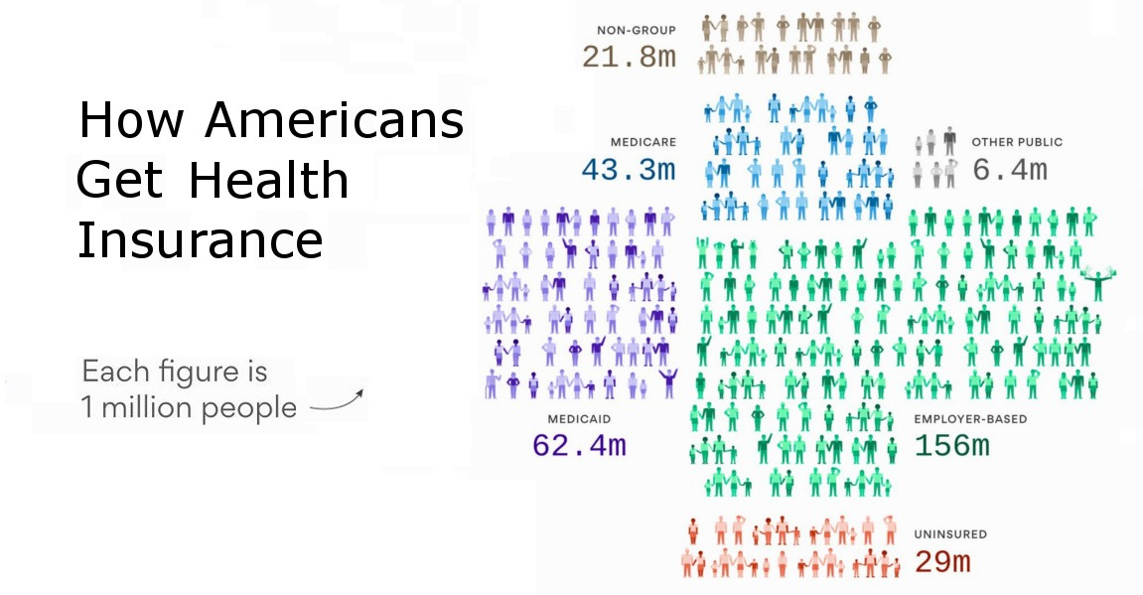
INDUSTRY REVIEW
Insurance providers have their own hospitals and doctors provides support only for them, and only certain kinds of treatments are also allowed in the plan that a person takes.

Slide 6

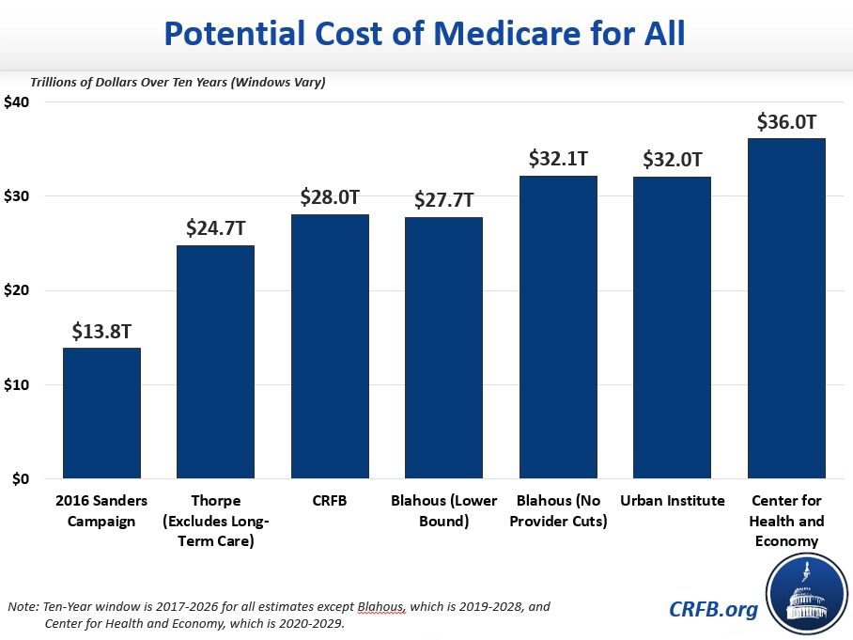
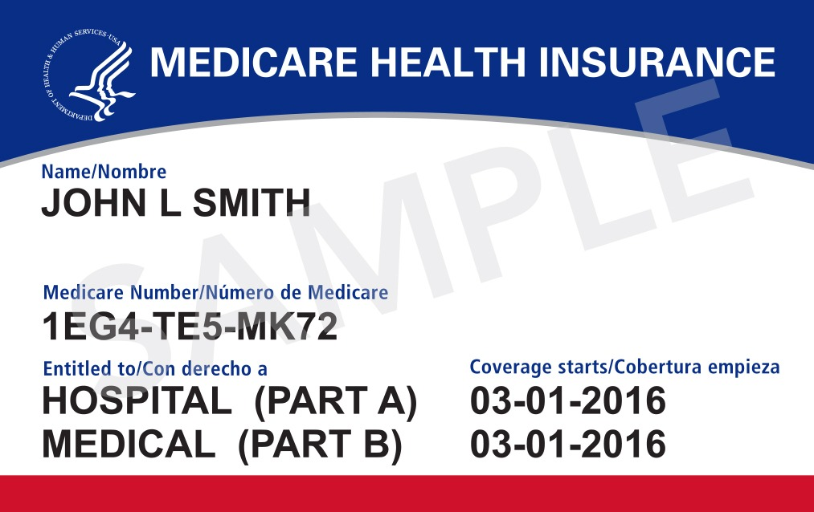
INDUSTRY REVIEW

Slide 7
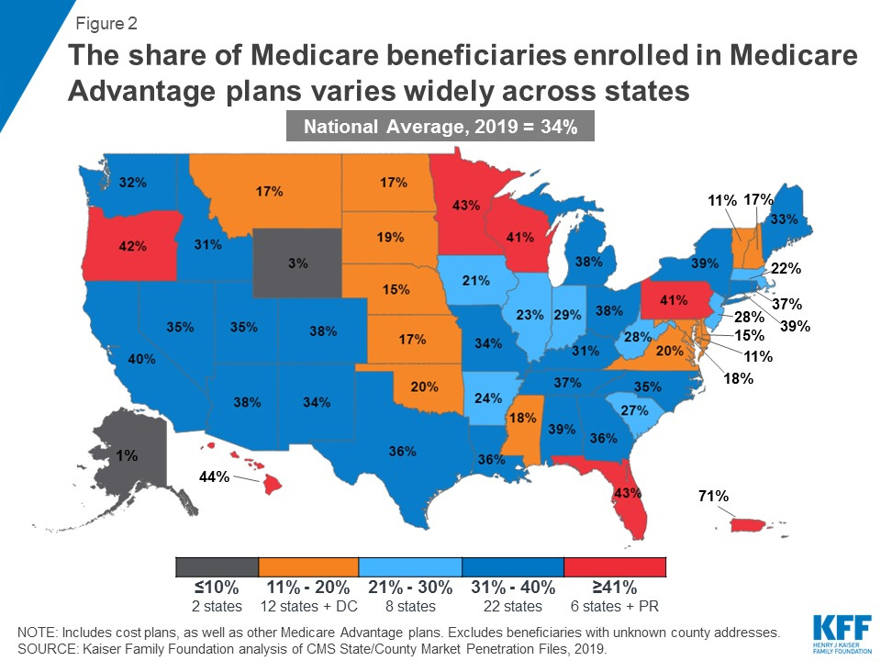

INDUSTRY REVIEW

Slide 8

INDUSTRY REVIEW

Slide 9
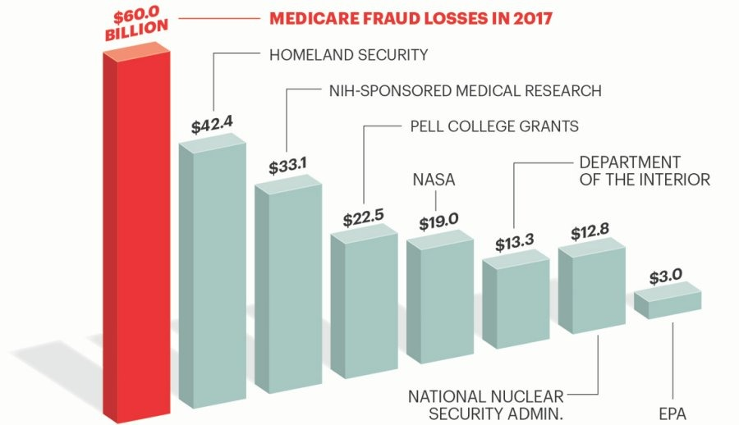
INDUSTRY REVIEW

Slide 10
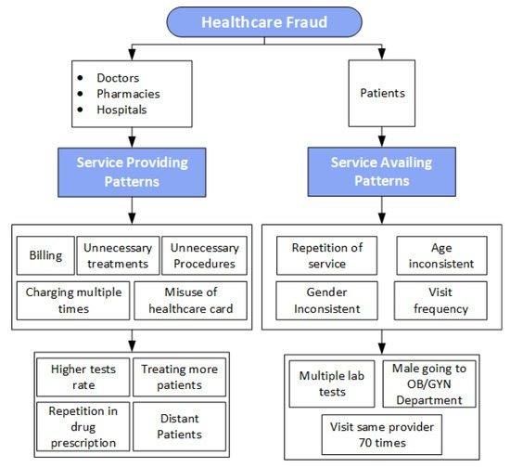
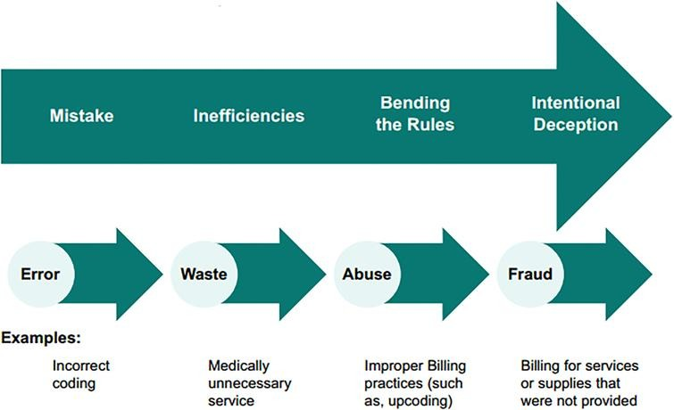
INDUSTRY REVIEW

Slide 11

METHODOLOGY
Fig Source: Wikipedia

Slide 12
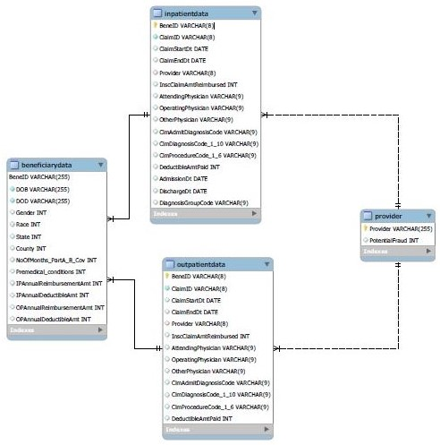
DATA DICTIONARY
Inpatient Data : It provides information about the claims filed for the patients who are admitted in the hospitals.
Outpatient Data : It provides information about the claims filed for the patients who visit hospitals but not admitted in the hospital.
Beneficiary Data : It provides the KYC details of both inpatient and outpatient data.
Provider Data : It provides details of the Provider ID and the Potential Fraud Claim.

Slide 13
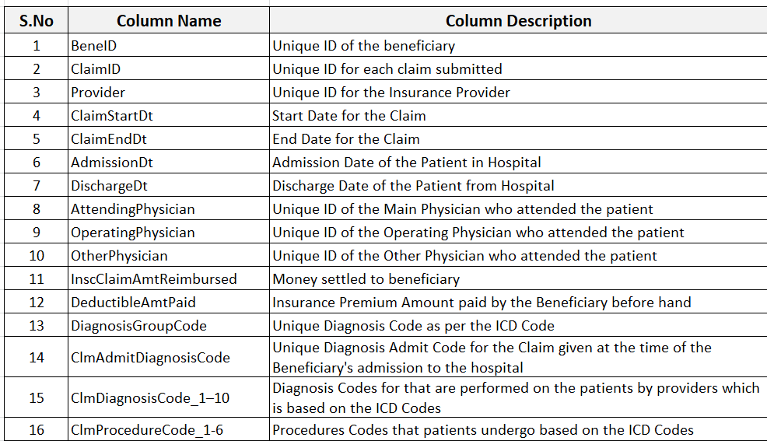
DATA DICTIONARY
Inpatient Data
40,474 Rows and 30 Columns
Outpatient Data
5,17,737 Rows and 27 Columns

Slide 14
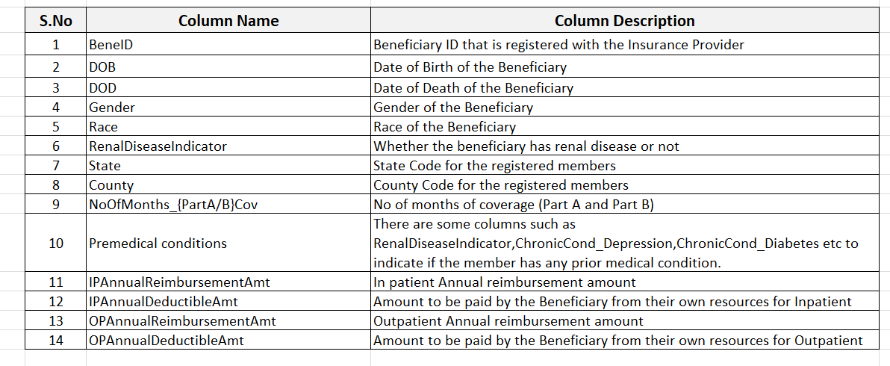
DATA DICTIONARY
Beneficiary Data
5,17,737 Rows and 27 Columns

Slide 15
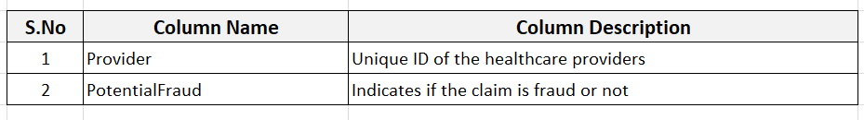
DATA DICTIONARY
Provider Data
5410 Rows and 2 Columns
INFERENCE FROM DATASET
PROBLEM STATEMENT
To predict the Potential Fraud, the target variable is identified as Potential Fraud (found in the Provider data). It is a binary classification problem where the output will be 1 if it is a counterfeited claim.
The probabilistic outputs are essential to calculate as they may help determine the chances of getting fraud.
The goal of the project is to predict the potential fraudulent providers based on the claims filed by them, thereby saving enormous amounts of money from frauds which would aid those who are in real need.
3,12,59,816 Data Points

Slide 16
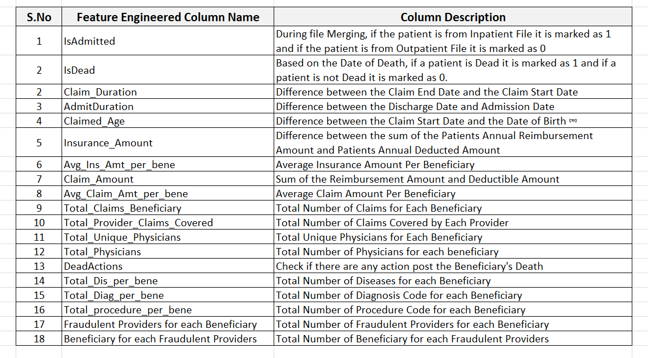
FEATURE ENGINEERING
3,46,09,082 Data Points

Slide 17
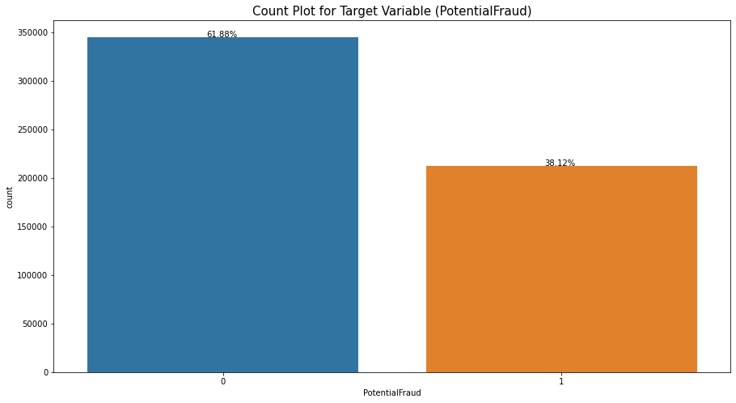
EDA
Distribution of Target Variable

Slide 18
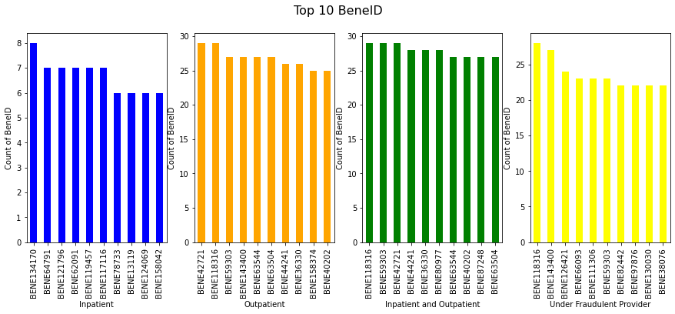
EDA
Top 10 BeneID
Univariate Analysis

Slide 19
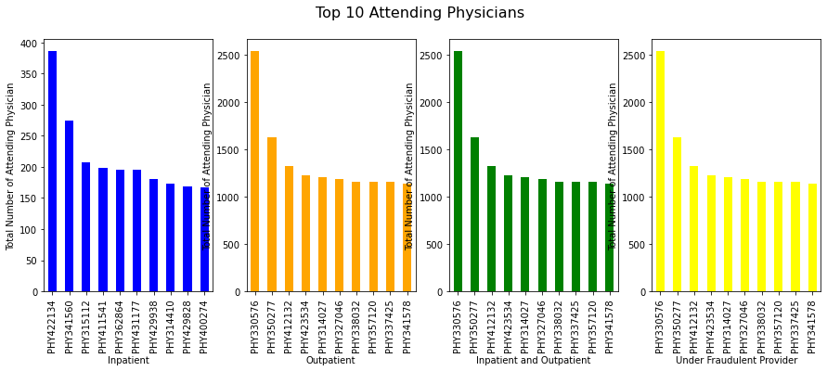
EDA
Top 10 Attending Physicians
Univariate Analysis

Slide 20
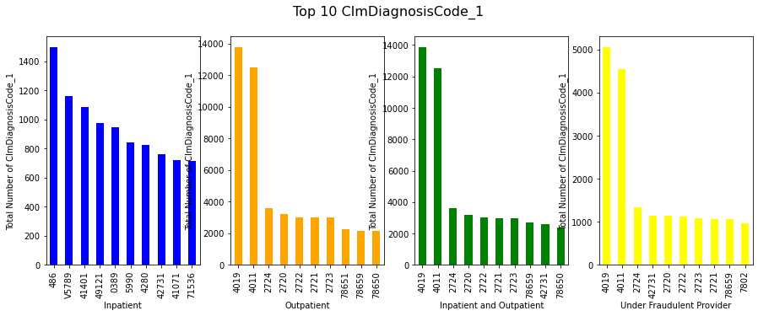
EDA
Top 10 Claim DiagnosisCode_1
Univariate Analysis

Slide 21
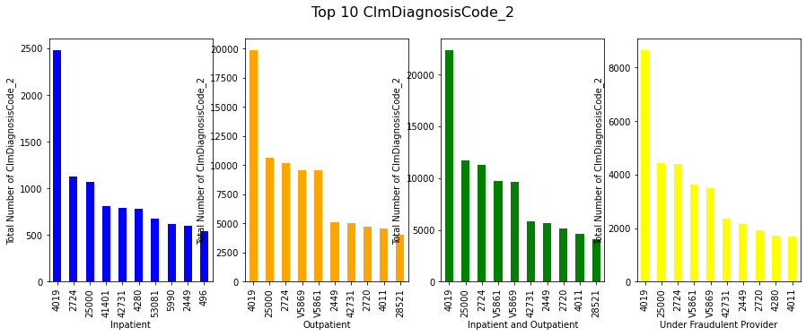
EDA
Top 10 Claim DiagnosisCode_2
Univariate Analysis

Slide 22
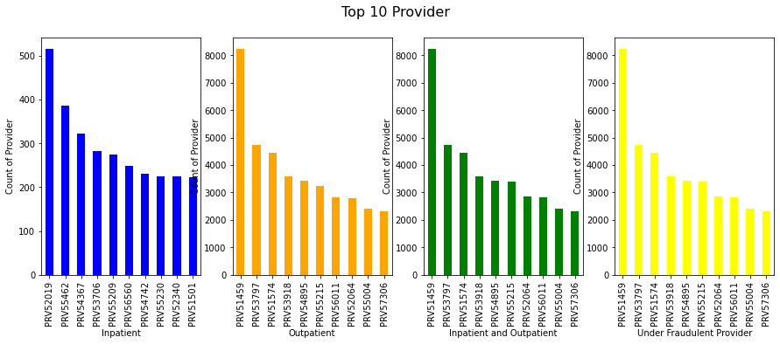
EDA
Univariate Analysis
Top 10 Provider

Slide 23
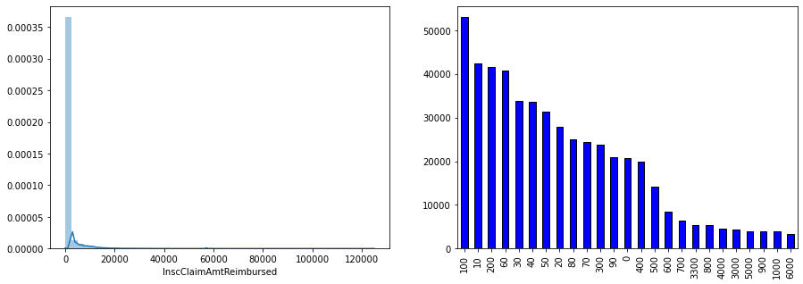
EDA
Univariate Analysis
InsClaimAmtReimbursed

Slide 24
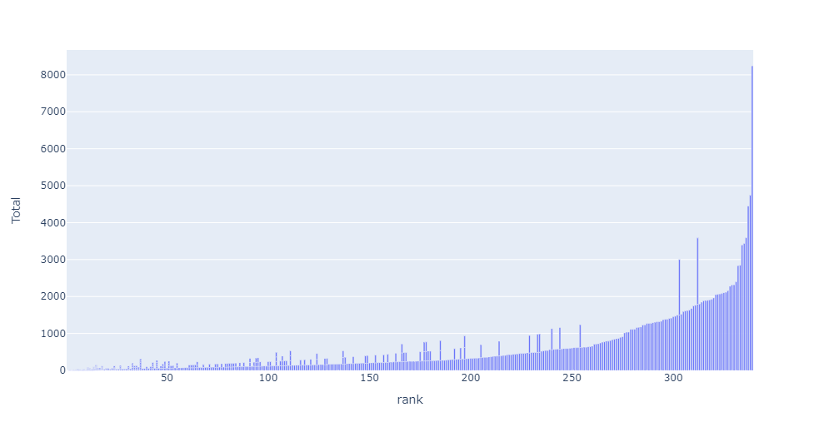
EDA
Bivariate Analysis
Top Beneficiary for each provider

Slide 25
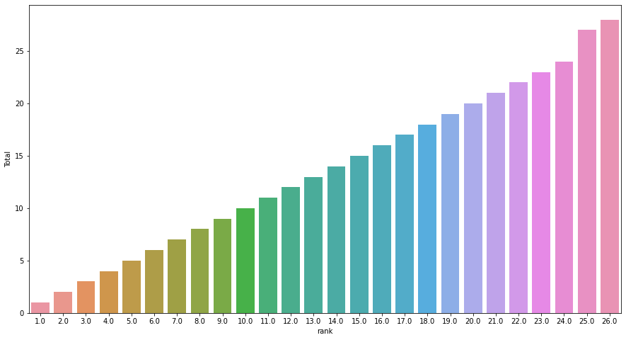
EDA
Bivariate Analysis
Top Fraudulent Provider for Each Beneficiary

Slide 26
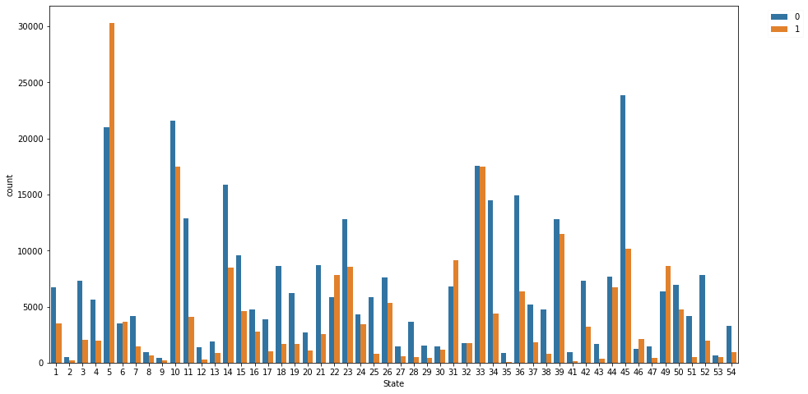
EDA
Bivariate Analysis
State Vs Potential Fraud

Slide 27
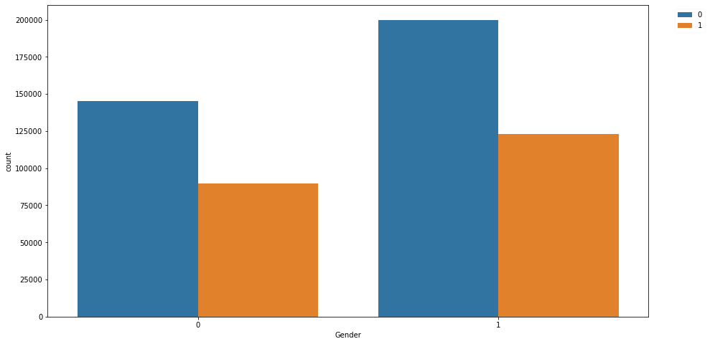
EDA
Bivariate Analysis
Gender and Potential Fraud

Slide 28
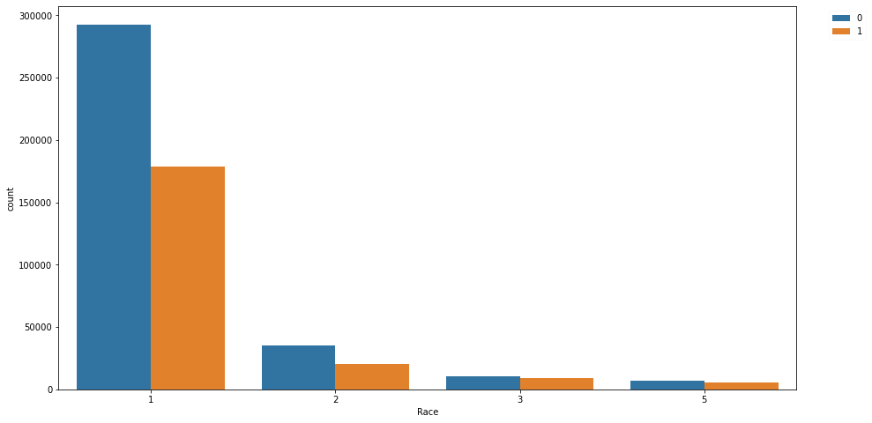
EDA
Bivariate Analysis
Race and Potential Fraud

Slide 29
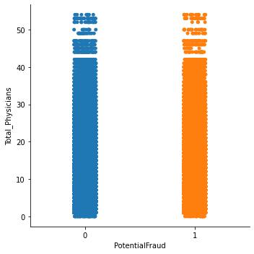
EDA
Bivariate Analysis
Total Physician and Potential Fraud

Slide 30
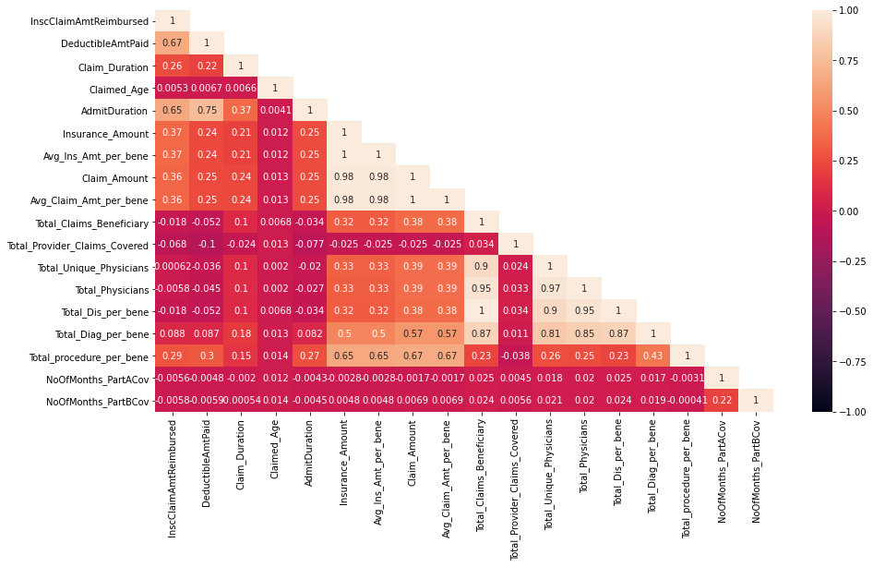
EDA
Multivariate Analysis
Correlation Matrix

Slide 31
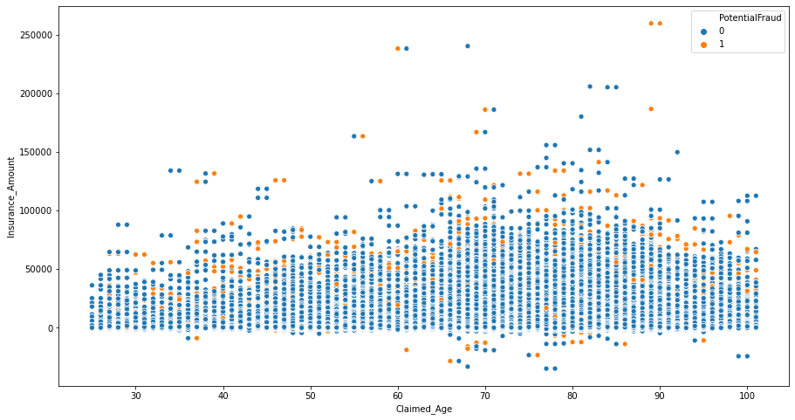
EDA
Multivariate Analysis
Claimed Age and Insurance Amount vs Potential Fraud

Slide 32
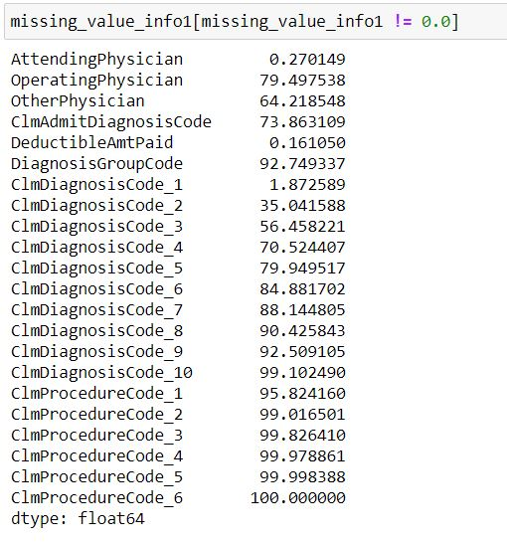
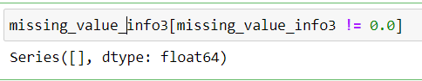
EDA
Missing Value Treatment
After Missing Value Treatment
Before Missing Value Treatment
2,45,61,284 Data Points

Slide 33
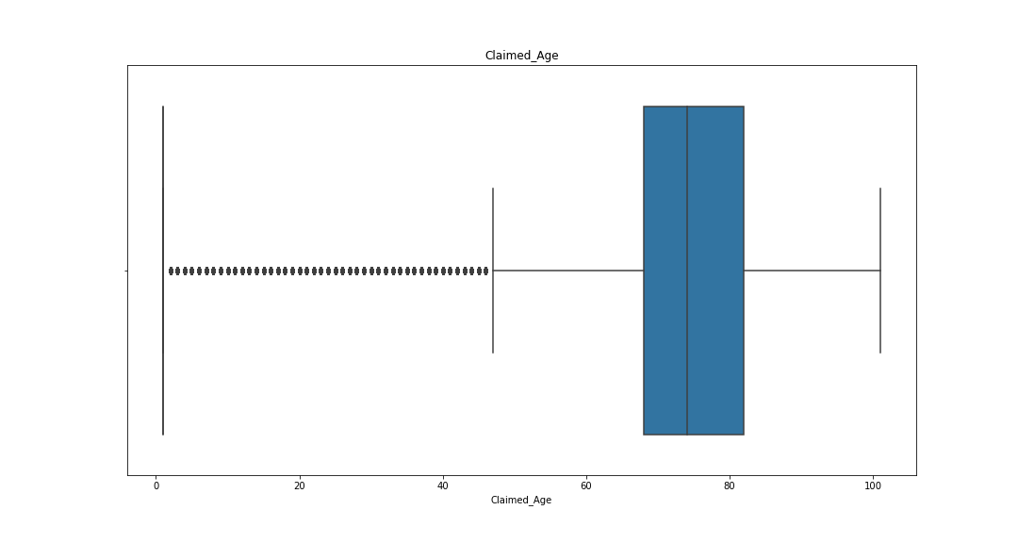
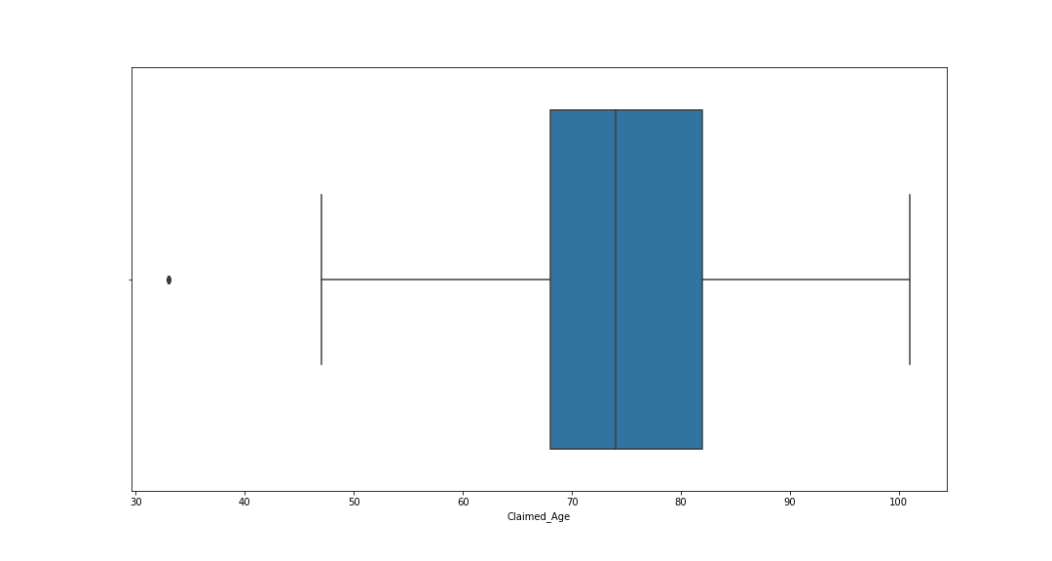
EDA
Outlier Treatment
Winsorization Technique
Before Outlier Treatment
After Outlier Treatment

Slide 34
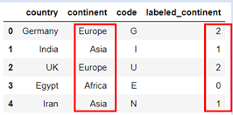
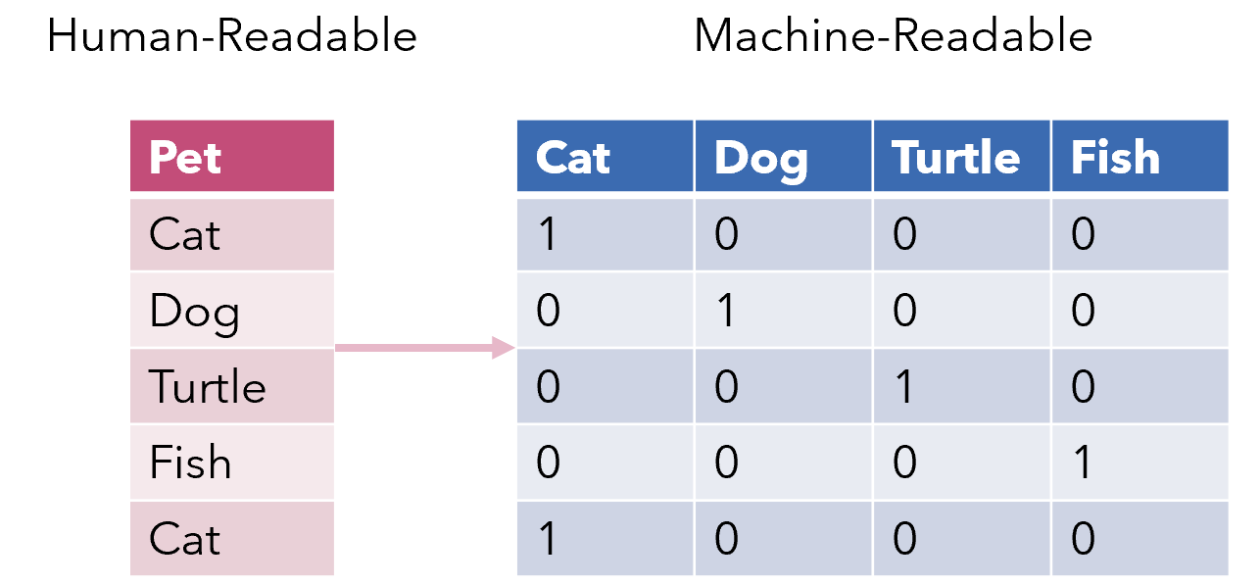
EDA
Encoding Categorical Variables
Label Encoding
One Hot Encoding
ChronicCond_Alzheimer
ChronicCond_Heartfailure
ChronicCond_KidneyDisease
ChronicCond_Cancer
ChronicCond_ObstrPulmonary
ChronicCond_Depression
ChronicCond_Diabetes
ChronicCond_IschemicHeart
ChronicCond_Osteoporasis
ChronicCond_rheumatoidarthritis
ChronicCond_stroke
Attending Physician
ClmDiagnosisCode_1
ClmDiagnosisCode_2
PotentialFraud
Gender
RenalDiseaseIndicator

Slide 35


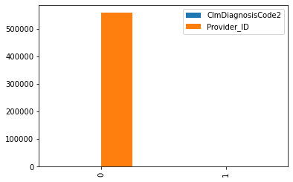
BUSINESS INSIGHTS

Slide 36

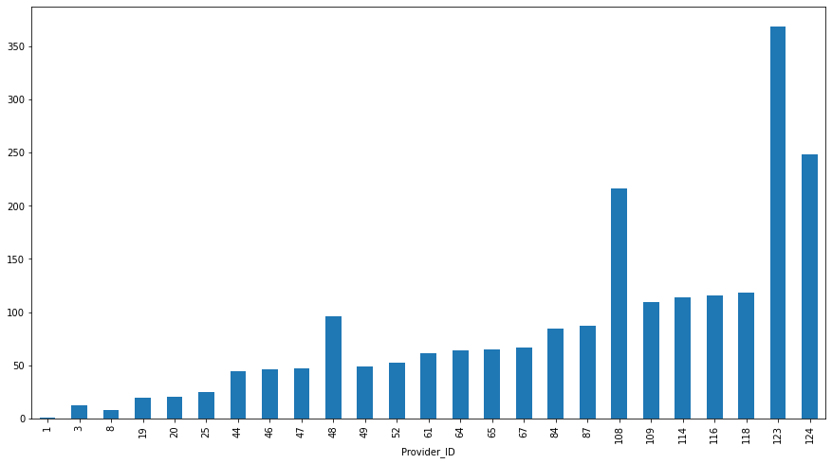
BUSINESS INSIGHTS
Insight 1

Slide 37
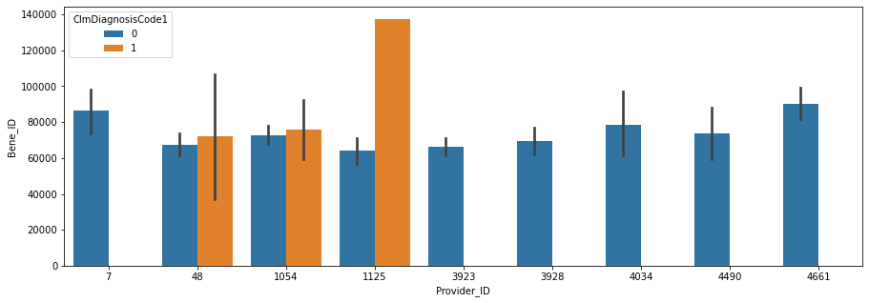
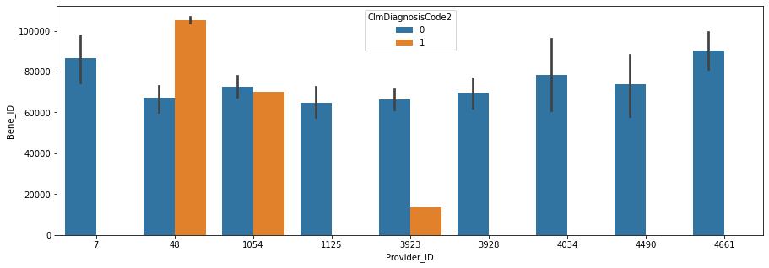
BUSINESS INSIGHTS
Insight 2

Slide 38
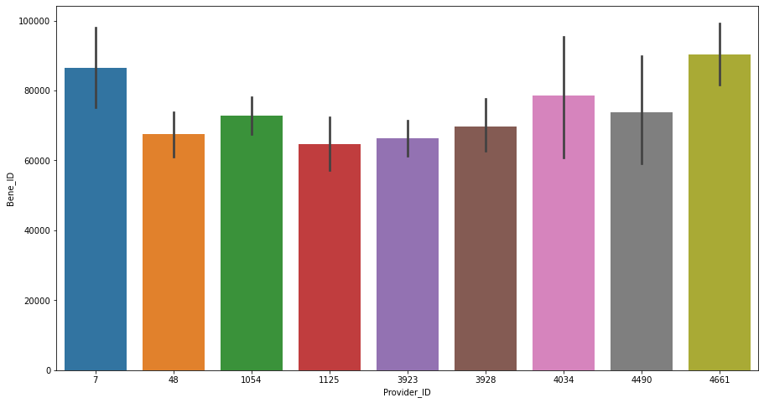
BUSINESS INSIGHTS
Insight 3

Slide 39




BUSINESS INSIGHTS
Insight 4
Insight 5
26713 patients
$ 29, 56, 81, 120

Slide 40
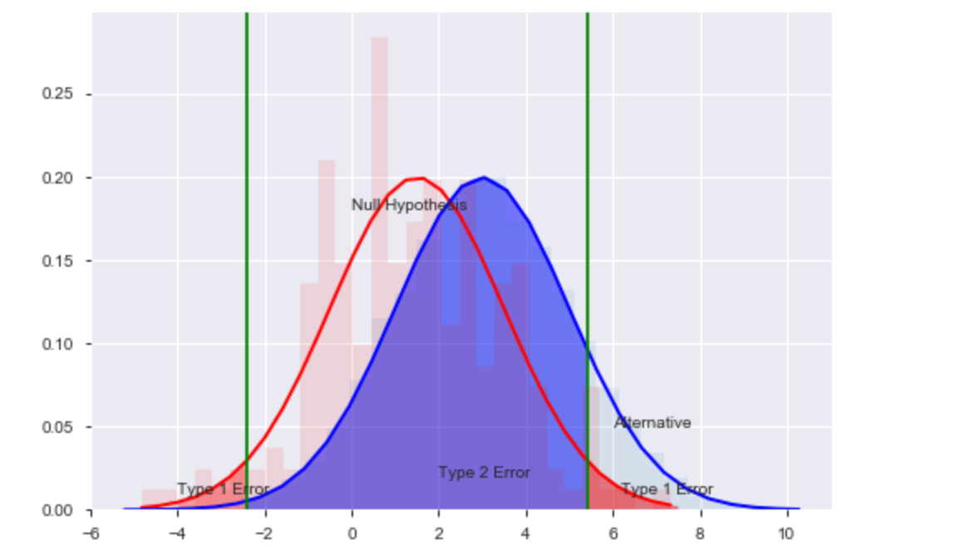
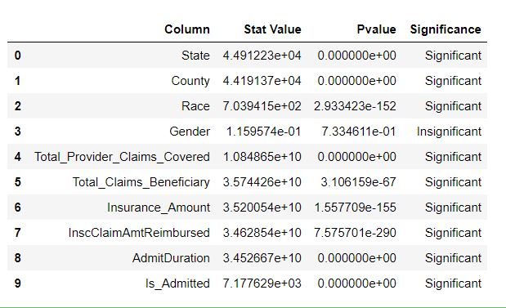
STATISTICAL SIGNIFICANCE OF VARIABLES

Slide 41
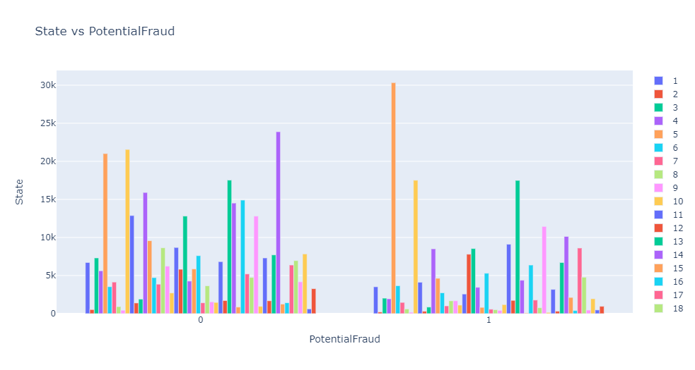
STATISTICAL SIGNIFICANCE OF VARIABLES
Test Performed | Chi Sqaure Contigency
Stats Value | 44912.23342
PVal | 0.0
Significance | Significant

Slide 42
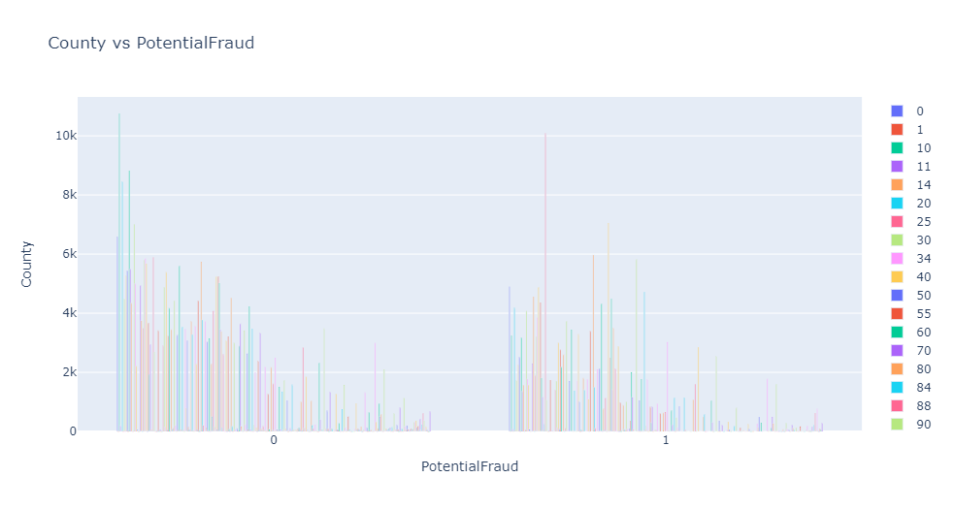
STATISTICAL SIGNIFICANCE OF VARIABLES
Test Performed | Chi Sqaure Contigency
Stats Value | 44191.3722666182
PVal | 0.0
Significance | Significant

Slide 43
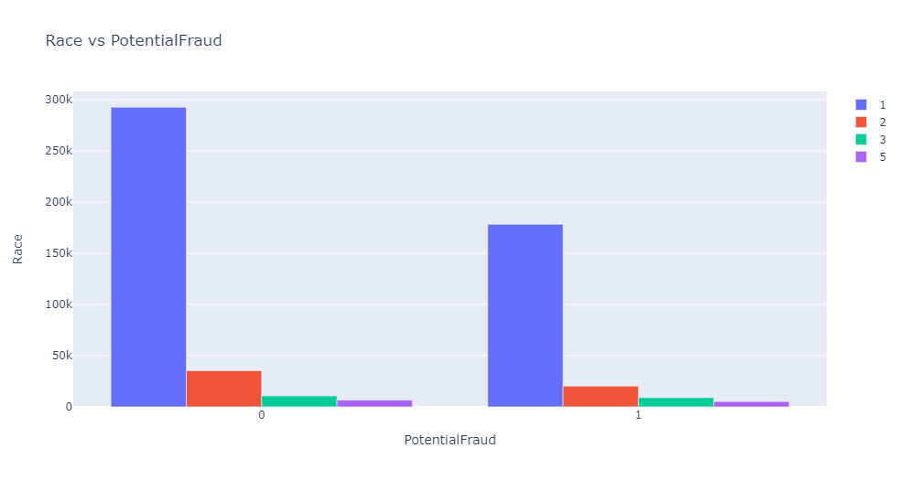
STATISTICAL SIGNIFICANCE OF VARIABLES
Test Performed | Chi Sqaure Contigency
Stats Value | 703.9414756354904
PVal | 2.933423389758317e-152
Significance | Significant

Slide 44
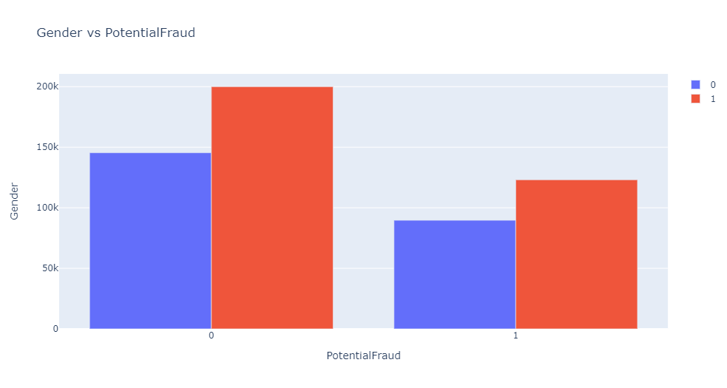
STATISTICAL SIGNIFICANCE OF VARIABLES
Test Performed | Chi Sqaure Contigency
Stats Value | 1.159574e-01
PVal | 1
Significance | Insignificant

Slide 45
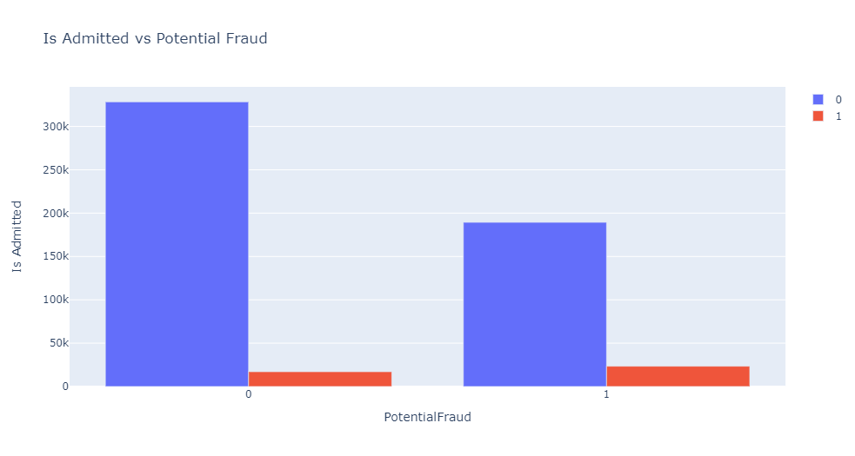
STATISTICAL SIGNIFICANCE OF VARIABLES
Test Performed | Chi Sqaure Contigency
Stats Value | 7.177629e+03
PVal | 0
Significance | Significant

Slide 46
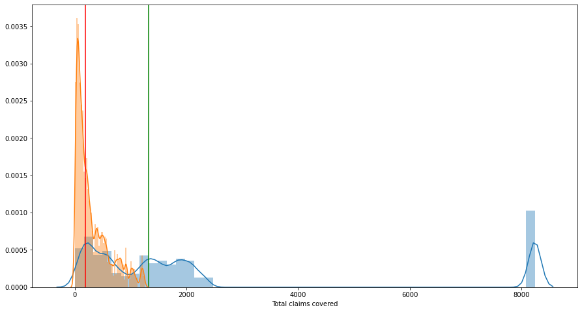
STATISTICAL SIGNIFICANCE OF VARIABLES
Total Claims Covered vs Potential Fraud
Test Performed | MannWhitneyU
Stats Value | 1.084865e+10
PVal | 0
Significance | Significant

Slide 47

STATISTICAL SIGNIFICANCE OF VARIABLES
Total Claims Beneficiary vs Potential Fraud
Test Performed | MannWhitneyU
Stats Value | 3.574426e+10
PVal | 0
Significance | Significant

Slide 48

STATISTICAL SIGNIFICANCE OF VARIABLES
STATISTICAL SIGNIFICANCE OF VARIABLES
Insurance Amount vs Potential Fraud
Test Performed | MannWhitneyU
Stats Value | 3.520054e+10
PVal | 1.557709e-67
Significance | Significant

Slide 49

STATISTICAL SIGNIFICANCE OF VARIABLES
Insurance Amount Reimbursement vs Potential Fraud
Test Performed | MannWhitneyU
Stats Value | 3.462854e+10
PVal | 7.575701e-290
Significance | Significant

Slide 50

STATISTICAL SIGNIFICANCE OF VARIABLES
Admit Duration vs Potential Fraud
Test Performed | MannWhitneyU
Stats Value | 3.452667e+10
PVal | 0.0
Significance | Significant

Slide 51



MODEL BUILDING
Logistic Regression Model

Slide 52


MODEL BUILDING
Logistic Regression Model
Scaling the Data

Slide 53

MODEL BUILDING
Logistic Regression Model
Assumption Checking
Multicollinearity Free
With Multicollinearity

Slide 54


MODEL BUILDING
Logistic Regression Model
Building Model Building and Model Evaluation
Train Test Split

Slide 55

MODEL BUILDING
Logistic Regression Model
Building Model Building and Model Evaluation
Confusion Matrix
True Positive | : | A fraud claim is correctly marked as fraud
True Negative | : | A non-fraudulent claim is correctly marked as non-fraud
False Positive | : | A non-fraudulent claim is marked as fraud claim
False Negative | : | A fraud claim is marked as non-fraud claim

Slide 56


MODEL BUILDING
Logistic Regression Model
Train Dataset Evaluation - Accuracy Score & Confusion Matrix

Slide 57


MODEL BUILDING
Logistic Regression Model
Test Dataset Evaluation - Accuracy Score & Confusion Matrix

Slide 58

MODEL BUILDING
Logistic Regression Model
Tuning Threshold
Threshold obtained = 1

Slide 59

MODEL BUILDING
Logistic Regression Model
Train Dataset Evaluation - Accuracy Score & Confusion Matrix

Slide 60

MODEL BUILDING
Logistic Regression Model
Test Dataset Evaluation - Accuracy Score & Confusion Matrix

Slide 61
MODEL BUILDING
Future Work
Random forest
Decision tree
Naive Bayes
Gradient Boost
Adaboost
XGboost

Slide 62
THANK YOU

